Slide 1
Influence of Adjuvant Pretreatment on Outcome of FIRE-3 (AIO KRK-0306): A Randomized Phase III Study of FOLFIRI Plus Cetuximab as First-Line Treatment for Wild-Type (WT) KRAS (Exon 2) Metastatic Coloreactal Cancer (mCRC) Patients
Abstract 515
Stintzing S, Modest DP, Fischer von Weikersthal L, Decker T, Kiani A, Vehling-Kaiser U, Al-Batran S-E, Heintges T, Lerchenmuller CA, Kahl C, Seipelt G, Kullmann F, Stauch M, Scheithauer W, Held S, Giessen CA, Moehler MH, Jung A, Kirchner T, Heinemann V

Slide 2

FIRE-3: Head-to-Head Study of Erbitux + FOLFIRI vs Bevacizumab (Bev) + FOLFIRI in First-Line mCRC¹
Open-label, randomized, multicenter, phase III investigator sponsored trial (IST)
Cetuximab (Cet) + FOLFIRI
(n = 297)
Patients with untreated KRAS exon 2 WT mCRC
N = 592
R
Bevacizumab + FOLFIRI
(n = 295)
Primary endpoint: Investigator-assessed overall response rate (ORR)
Secondary endpoints: Progression-free survival (PFS), overall survival (OS), time to failure of strategy, depth of response, independent read of ORR, secondary resection rate, and safety
Amended October 2008 to include only patients with KRAS exon 2 WT mCRC
113 patients with KRAS exon 2 mutated mCRC were enrolled before the amendment
Retrospective RAS subgroup analysis (RAS-evaluable population, including both RAS WT and new RAS mutated: n = 407)
Heinemann V, et al. Lancet Oncol. 2014;15(10):1065-1075.
Stintzing S, et al. J Clin Oncol. 2015;33(suppl 3): Abstract 515.
Notes:
2

Slide 3
KRAS Exon 2 WT (Intent-to-Treat [ITT]; n = 592)
1.0
 | Events n/N (%) | Median (months) | 95% CI
FOLFIRI + cetuximab | 158/297 (53.2%) | 28.7 | 24.0-36.6
FOLFIRI + bevacizumab | 185/295 (62.7%) | 25.0 | 22.7-27.6
0.75
Probability of Survival
0.50
HR 0.77 (0.62-0.96)
P = .017
0.25
Δ = 3.7 months
0.0
0.0
12
24
36
48
60
72
Months Since Start of Treatment
 | ITT population, KRAS exon 2 WT
 | Cet + chemo (n = 297) | Bev + chemo (n = 295)
ORR, % | 62.0 | 58.0
Odds ratio P value | 1.18, P = .183*
PFS, months | 10.0 | 10.3
HR, P value | 1.06, P = .547
Heinemann V, et al. Lancet Oncol. 2014;15(10):1065-1075.
Stintzing S, et al. J Clin Oncol. 2015;33(suppl 3): Abstract 515.

Slide 4
RAS WT (n = 400)
 | Events n/N (%) | Median (months) | 95% CI
FOLFIRI + cetuximab | 107/199 (53.8%) | 33.1 | 24.5-39.4
FOLFIRI + bevacizumab | 133/201 (66.2%) | 25.0 | 23.0-28.1
1.0
0.75
Probability of Survival
0.50
HR 0.697 (0.54-0.90) P = .0059
0.25
Δ = 8.1 months
0.0
12
24
36
48
60
72
Months Since Start of Treatment
 | ITT population, KRAS exon 2 WT
 | Cet + chemo (n = 297) | Bev + chemo (n = 295)
ORR*, % | 65.3 | 58.7
Odds ratio, P value | 1.33, P = .18*
PFS, months | 10.3 | 10.2
HR, P value | 0.97, P = .77
P, logrank test; P*, one-sided Fisher’s exact test
Stintzing S, et al. J Clin Oncol. 2015;33(suppl 3): Abstract 515.

Slide 5
Populations
ITT
(N = 592)
KRAS exon 2 WT
FOLFIRI + Cet
(N = 297)
FOLFIRI + Bev
(N = 295)
No
adjuvant chemo
N = 229
Any
adjuvant chemo
N = 68
No
adjuvant chemo
N = 239
Any
adjuvant chemo
N = 56
Adjuvant chemo
with oxaliplatin
N = 34
Adjuvant chemo
without oxaliplatin
N = 34
Adjuvant chemo
with oxaliplatin
N = 24
Adjuvant chemo
without oxaliplatin
N = 32
Stintzing S, et al. J Clin Oncol. 2015;33(suppl 3): Abstract 515.

Slide 6
Populations
RAS WT
(N = 400)
Extended RAS WT
FOLFIRI + Cet
(N = 199)
FOLFIRI + Bev
(N = 201)
No
adjuvant chemo
N = 162
Any
adjuvant chemo
N = 37
No
adjuvant chemo
N= 163
Any
adjuvant chemo
N = 38
Adjuvant chemo
with oxaliplatin
N = 18
Adjuvant chemo
without oxaliplatin
N = 19
Adjuvant chemo
with oxaliplatin
N = 19
Adjuvant chemo
without oxaliplatin
N = 17
Stintzing S, et al. J Clin Oncol. 2015;33(suppl 3): Abstract 515.

Slide 7
Baseline Characteristics (KRAS Exon 2 WT)
Characteristic | Adjuvant treatment without oxaliplatin |  | Adjuvant treatment with oxaliplatin |  | Total (n = 124)
 | FOLFIRI cetuximab (n = 34) | FOLFIRI bevacizumab (n = 32) | FOLFIRI cetuximab (n = 34) | FOLFIRI bevacizumab (n = 24)
Sex Male, % (n) Female, % (n) | 71% (24) 29% (10) | 81% (26) 19% (6) | 59% (20) 41% (14) | 58% (14) 42% (10) | 68% (84) 32% (40)
Age Median, years Categories, % (n) ≤65 years >65 years ≥70 years | 68 41% (14) 59% (20) 35% (12) | 64 63% (20) 37% (12) 19% (6) | 62 65% (22) 35% (12) 21% (7) | 68 33% (8) 67% (16) 46% (11) | 65 52% (64) 48% (60) 29% (36)
ECOG % (n) 0 1 2 | 59% (20) 41% (14) 0% (0) | 56% (18) 41% (13) 3% (1) | 68% (23) 29% (10) 3% (1) | 46% (11) 54% (13) 0% (0) | 58% (72) 40% (50) 2% (2)
Lab values, % (n) Leukocytes ≥8000/μl AP ≥300/μl | 18% (6) 6% (2) | 16% (5) 6% (2) | 27% (9) 3% (1) | 13% (3) 0% (0) | 19% (23) 4% (5)
Stintzing S, et al. J Clin Oncol. 2015;33(suppl 3): Abstract 515.

Slide 8
Baseline Characteristics (KRAS Exon 2 WT) Cont
Characteristic | Adjuvant treatment without oxaliplatin |  | Adjuvant treatment with oxaliplatin |  | Total (n = 124)
 | FOLFIRI cetuximab (n = 34) | FOLFIRI bevacizumab (n = 32) | FOLFIRI cetuximab (n = 34) | FOLFIRI bevacizumab (n = 24)
Site of primary, % (n) Right colon Left colon Rectum | 6% (2) 94% (32) 77% (26) | 6% (2) 94% (30) 78% (25) | 32% (11) 68% (23) 29% (10) | 29% (7) 71% (17) 46% (11) | 18% (22) 82% (102) 58% (72)
Metastatic sites, % (n) 1 site ≥2 sites Unknown | 44% (15) 56% (19) 0% (0) | 47% (15) 53% (17) 0% (0) | 35% (12) 65% (22) 0% (0) | 42% (10) 58% (14) 0% (0) | 42% (52) 58% (72) 0% (0)
Metastatic sites, % (n) Liver Liver only Liver not affected Unknown | 59% (20) 27% (9) 41% (14) 0% (0) | 50% (16) 19% (6) 50% (16) 0% (0) | 47% (16) 6% (2) 53% (18) 0% (0) | 54% (13) 8% (2) 46% (1) 0% (0) | 52% (65) 15% (19) 48% (59) 0% (0)
Prior treatment, % (n) Surgery Radiotherapy | 100% (34) 74% (25) | 94% (30) 72% (23) | 100% (34) 32% (11) | 100% (24) 38% (9) | 98% (122) 55% (68)
Stintzing S, et al. J Clin Oncol. 2015;33(suppl 3): Abstract 515.

Slide 9
Primary Outcome Measurements (KRAS Exon 2 WT)
 | No adjuvant treatment |  | P | Any adjuvant treatment |  | P
 | FOLFIRI cetuximab (n = 229) | FOLFIRI bevacizumab (n = 239) |  | FOLFIRI cetuximab (n = 68) | FOLFIRI bevacizumab (n = 56)
ORR %, (n) | 62 (143) | 61 (145) | 0.71 | 60 (41) | 48 (27) | 0.21
PFS, months (95% CI) | 10.0 (8.8-11.1) | 10.5 (9.9-11.6) | 0.91 | 9.4 (7.4-12.3) | 9.7 (8.8-10.8) | 0.36
 | Adjuvant treatment without oxaliplatin |  | P | Adjuvant treatment with oxaliplatin |  | P
 | FOLFIRI cetuximab (n = 34) | FOLFIRI bevacizumab (n = 32) |  | FOLFIRI cetuximab (n = 34) | FOLFIRI bevacizumab (n = 24)
ORR %, (n) | 62% (21) | 47% (15) | 0.32 | 58.8 (20) | 50 (12) | 0.60
PFS, months (95% CI) | 8.6 (6.4-12.9) | 9.4 (7.8-10.8) | 0.69 | 10.2 (6.8-12.8) | 10.3 (8.8-12.0) | 0.30
Stintzing S, et al. J Clin Oncol. 2015;33(suppl 3): Abstract 515.

Slide 10
Primary Outcome Measurements (RAS WT)
 | No adjuvant treatment |  | P | Any adjuvant treatment |  | P
 | FOLFIRI cetuximab (n = 162) | FOLFIRI bevacizumab (n = 163) |  | FOLFIRI cetuximab (n = 37) | FOLFIRI bevacizumab (n = 38)
ORR %, (n) | 64 (103) | 63 (102) | 0.91 | 73 (27) | 42 (16) | 0.01
PFS, months (95% CI) | 10.5 (9.3-11.8) | 11.1 (9.8-12.3) | 0.55 | 10.2 (7.2-13-3) | 9.9 (8.6-11.9) | 0.59
 | Adjuvant treatment without oxaliplatin |  | P | Adjuvant treatment with oxaliplatin |  | P
 | FOLFIRI cetuximab (n = 18) | FOLFIRI bevacizumab (n = 21) |  | FOLFIRI cetuximab (n = 19) | FOLFIRI bevacizumab (n = 17)
ORR %, (n) | 72 (14) | 38 (8) | 0.05 | 74 (13) | 47 (8) | 0.17
PFS, months (95% CI) | 8.5 (5.5-12.2) | 9.3 (6.9-10.3) | 0.91 | 10.2 (7.2-13-3) | 9.9 (8.6-11.9) | 0.59
Stintzing S, et al. J Clin Oncol. 2015;33(suppl 3): Abstract 515.

Slide 11
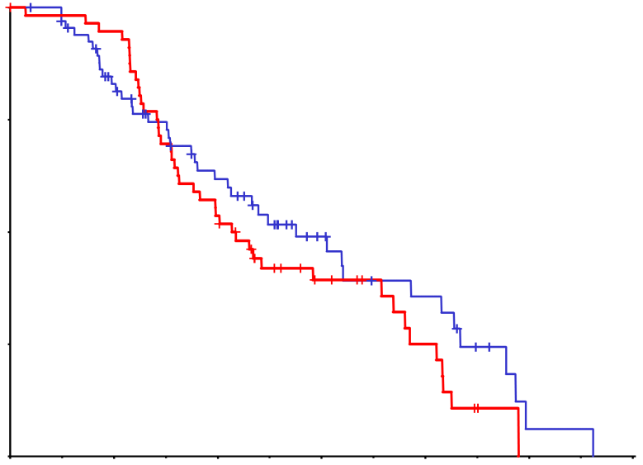
Overall Survival According to Adjuvant Pretreatment (KRAS Exon 2 WT)
No adjuvant treatment
Any adjuvant treatment
1.0
1.0
FOLFIRI + cetuximab (n = 229)
27.5 (22.6-33.1)
FOLFIRI + bevacizumab (n = 239)
25.0 (23.1-28.0)
FOLFIRI + cetuximab (n = 68)
33.1 (23.7-49.8)
FOLFIRI + bevacizumab (n = 56) 25.6 (19.4-42.9)
0.75
0.75
Probability of Survival
0.50
Probability of Survival
0.50
Logrank test
P = .06
HR: 0.80
Logrank test
P = .26
HR: 0.70
0.25
0.25
0.0
0.0
0.0
12
24
36
48
60
72
0.0
12
24
36
48
60
72
Months Since Randomization
Months Since Randomization
Adjuvant treatment without oxaliplatin
Adjuvant treatment with oxaliplatin
1.0
1.0
FOLFIRI + cetuximab (n = 34) 38.3 (20.9-57.3)
FOLFIRI + bevacizumab (n = 32)
20.1 (17.1-35.0)
FOLFIRI + cetuximab (n = 34)
33.1 (23.7-38.5)
FOLFIRI + bevacizumab (n = 24)
44.3 (23.7-49.9)
0.75
0.75
Probability of Survival
Probability of Survival
0.50
0.50
Logrank test
P = .045
HR:0.54
Logrank test
P = .58
HR: 1.22
0.25
0.25
0.0
0.0
0.0
12
24
36
48
60
72
0.0
12
24
36
48
60
72
Months Since Randomization
Months Since Randomization
Stintzing S, et al. J Clin Oncol. 2015;33(suppl 3): Abstract 515.

Slide 12
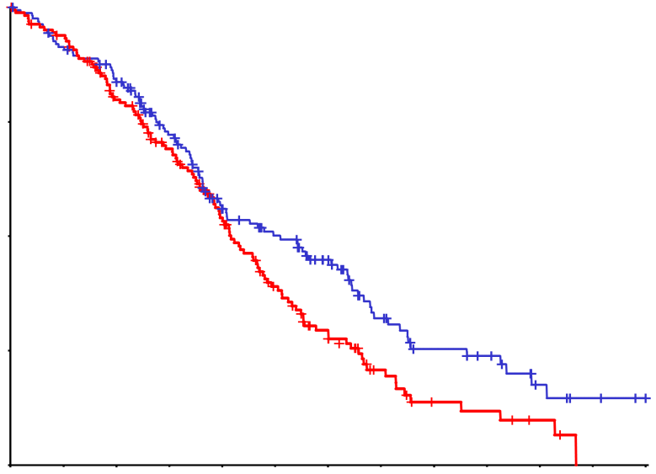
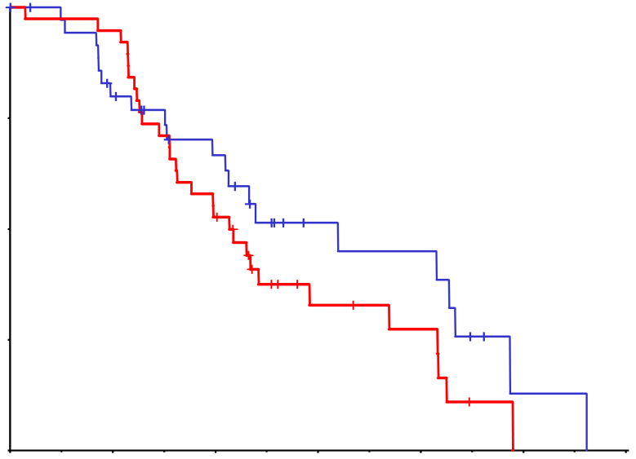
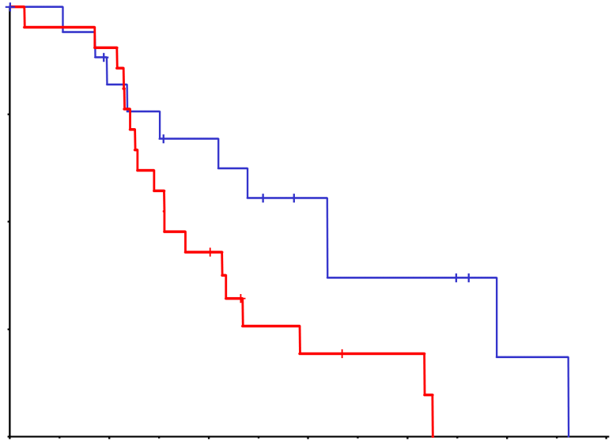
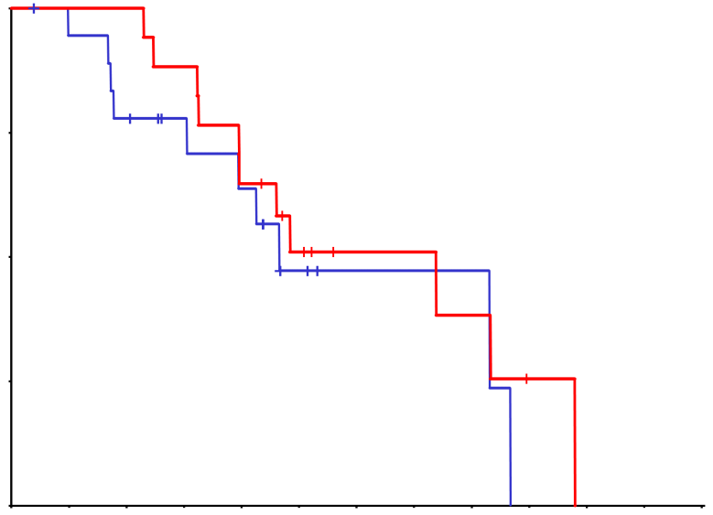
Overall Survival According to Adjuvant Pretreatment (RAS WT)
No adjuvant treatment
Any adjuvant treatment
1.0
FOLFIRI + cetuximab (n = 162)
30.6 (23.6-38.3)
FOLFIRI + bevacizumab (n = 163)
25.0 (23.0-28.6)
1.0
FOLFIRI + cetuximab (n = 37)
38.3 (25.2-52.0)
FOLFIRI + bevacizumab (n = 38) 25.6 (19.4-35.0)
0.75
0.75
Probability of Survival
0.50
0.50
Probability of Survival
Logrank test
P = .03
HR: 0.74
Logrank test
P = .22
HR: 0.70
0.25
0.25
0.0
0.0
0.0
12
24
36
48
60
72
0.0
12
24
36
48
60
72
Months Since Randomization
Months Since Randomization
Adjuvant treatment without oxaliplatin
Adjuvant treatment with oxaliplatin
1.0
1.0
FOLFIRI + cetuximab (n = 18)
38.3 (18.1-58.4)
FOLFIRI + bevacizumab (n = 21)
18.7 (15.1-28.1)
FOLFIRI + cetuximab (n = 19)
27.9 (18.3-52.0)
FOLFIRI + bevacizumab (n = 17)
44.3 (23.7-58.7)
0.75
0.75
Probability of Survival
Probability of Survival
0.50
0.50
0.25
Logrank test
P = .03
HR: 0.40
0.25
Logrank test
P = .42
HR: 1.44
0.0
0.0
0.0
0.0
12
24
36
48
60
72
12
24
36
48
60
72
Months Since Randomization
Months Since Randomization
Stintzing S, et al. J Clin Oncol. 2015;33(suppl 3): Abstract 515.

Slide 13
Conclusions
Results in patients treated with adjuvant chemotherapy mirrored those in the whole study population
In adjuvant pretreated RAS WT patients, a significantly higher ORR was reached in the cetuximab arm when compared to the bevacizumab arm (P = .01)
The role of adjuvant treatment on efficacy of first-line therapy remains to be further evaluated
Stintzing S, et al. J Clin Oncol. 2015;33(suppl 3): Abstract 515.

